Slide 1
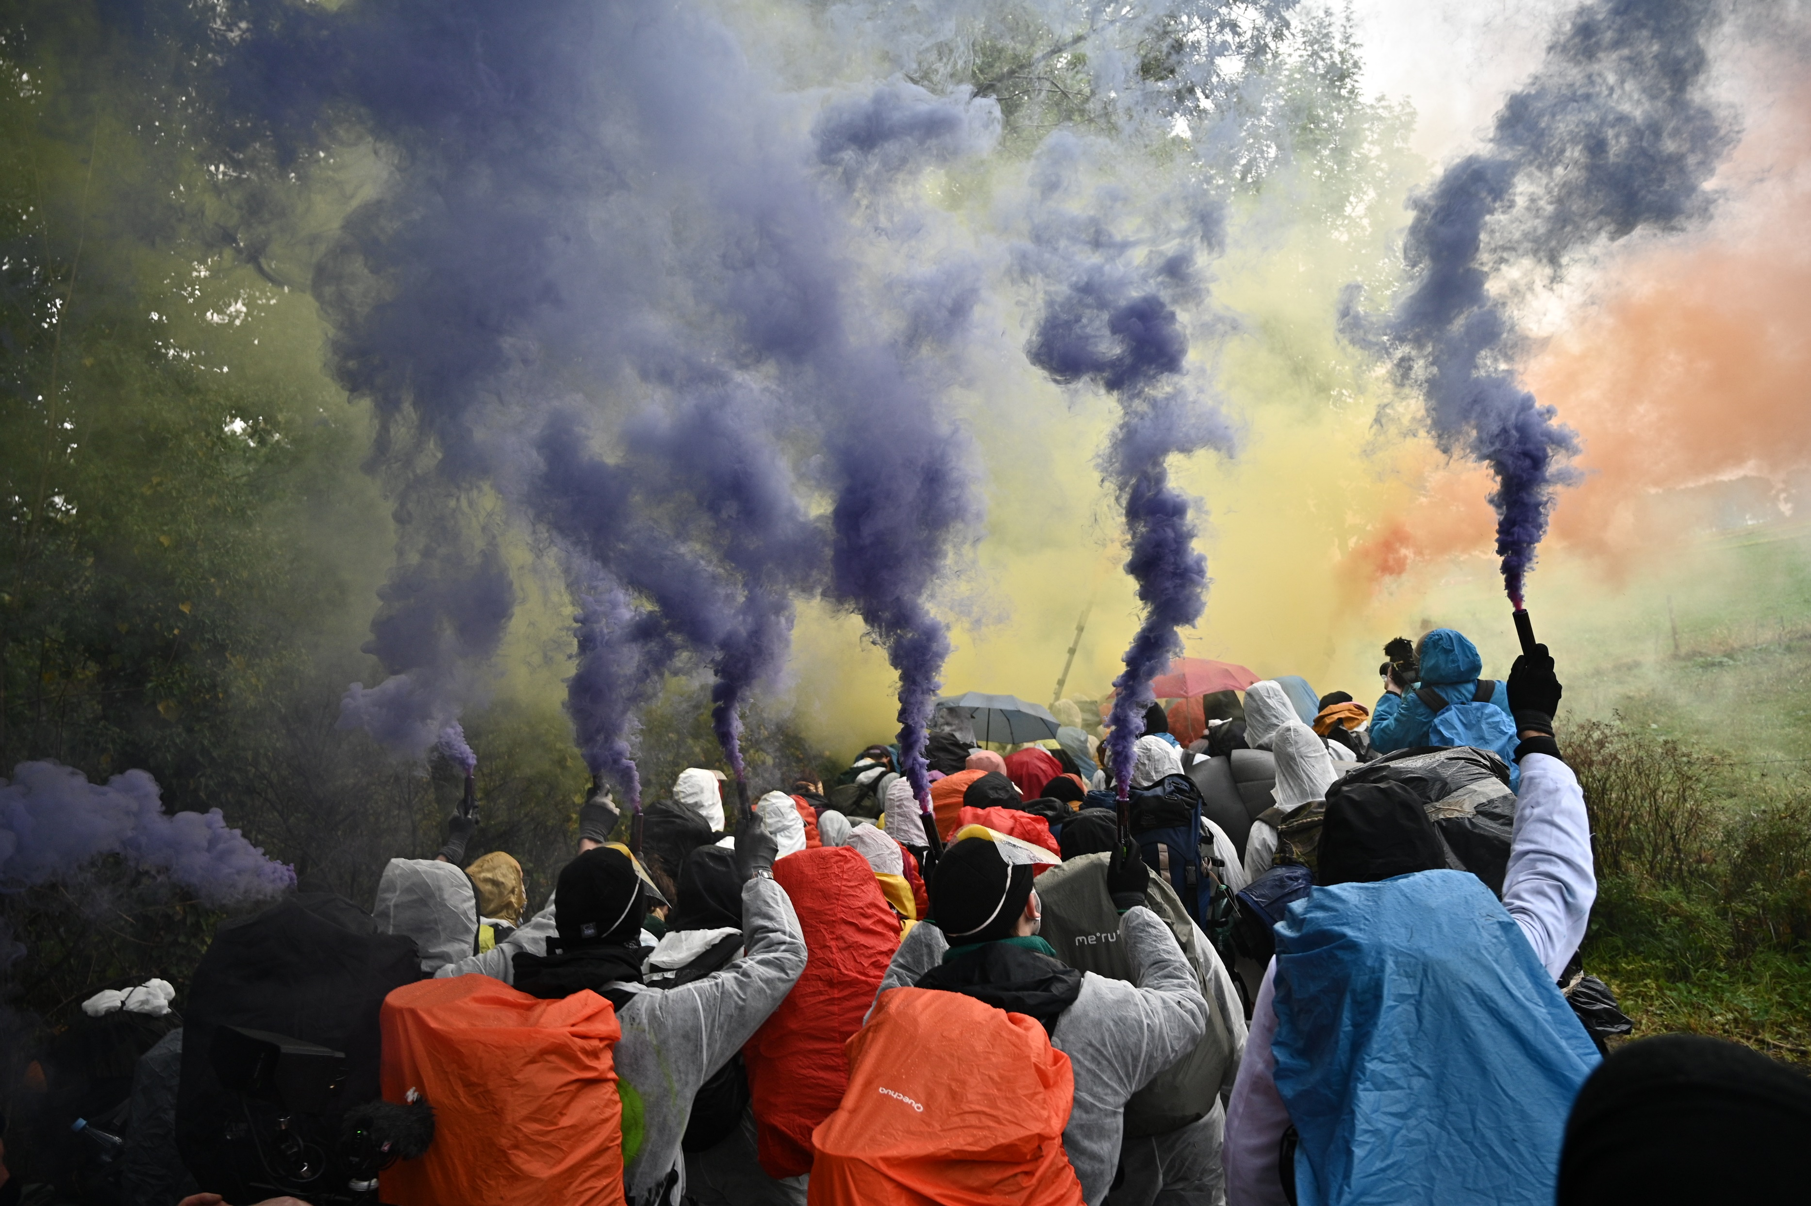


Ende Gelände GOES Rügen 22.-24.09.23

Slide 2

CONTENT
1) CLIMATE JUSTICE
2) Frack off LNG!
3) WHAT IS HAPPENING ON RÜGEN?
4) Ende Gelände GOES Rügen

Slide 3
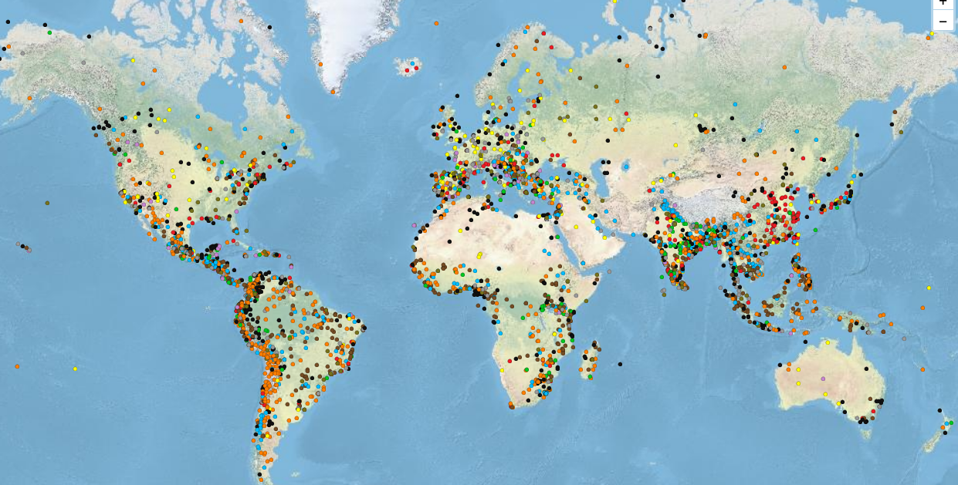
1) CLIMATE JUSTICE
Notes:
https://www.cinerebelde.org/wake-up-freak-out-then-get-grip-p-83.html?language=de

Slide 4
CLIMATE (iN)JUSTICE
EXRACTION OF FOSSILE ENERGY
DESTRUCTION OF LIVELIHOODS, ESPECIALLY IN THE GLOBAL SOUTH AND ON INDIGENOUS TERRITORIES
Profits for companies, primarily From the global north
CLIMATE CRISIS
People from the Global South are already losing their livelihoods due to climate catastrophes
Europe is closing itself off, allowing thousands of people to die at its borders, and abolishing the human right to asylum
Notes:
IPCC:
Assessment Reports 1990, 1995, 2001, 2007, 2014
Umweltgerechtigkeit!
80er Jahre
giftige Industrien vor allem bei PoCs

Slide 5
ANTI-COLONIAL Restistances
For over 500 years, there has been resistance against this colonial, capitalist, and patriarchal exploitation
We aim to amplify this resistance in solidarity AS We are fighting for a radical change in the system – uncompromising, anticapitalist, anticolonial.
Notes:
IPCC:
Assessment Reports 1990, 1995, 2001, 2007, 2014
Umweltgerechtigkeit!
80er Jahre
giftige Industrien vor allem bei PoCs

Slide 6
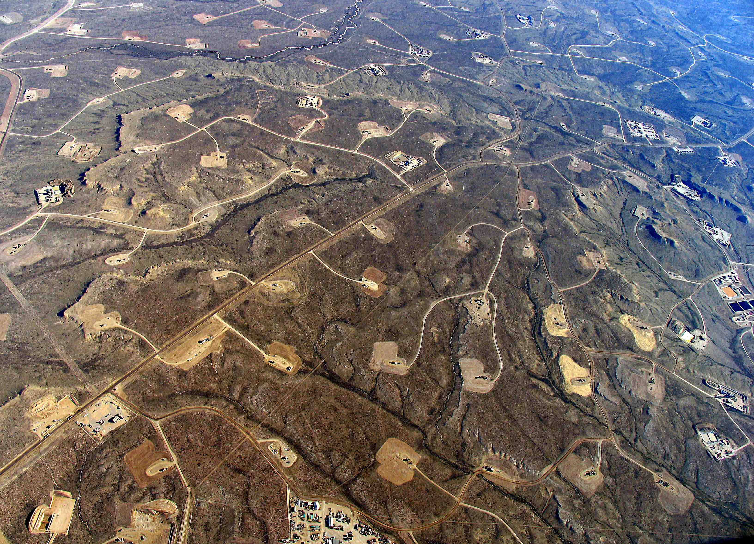
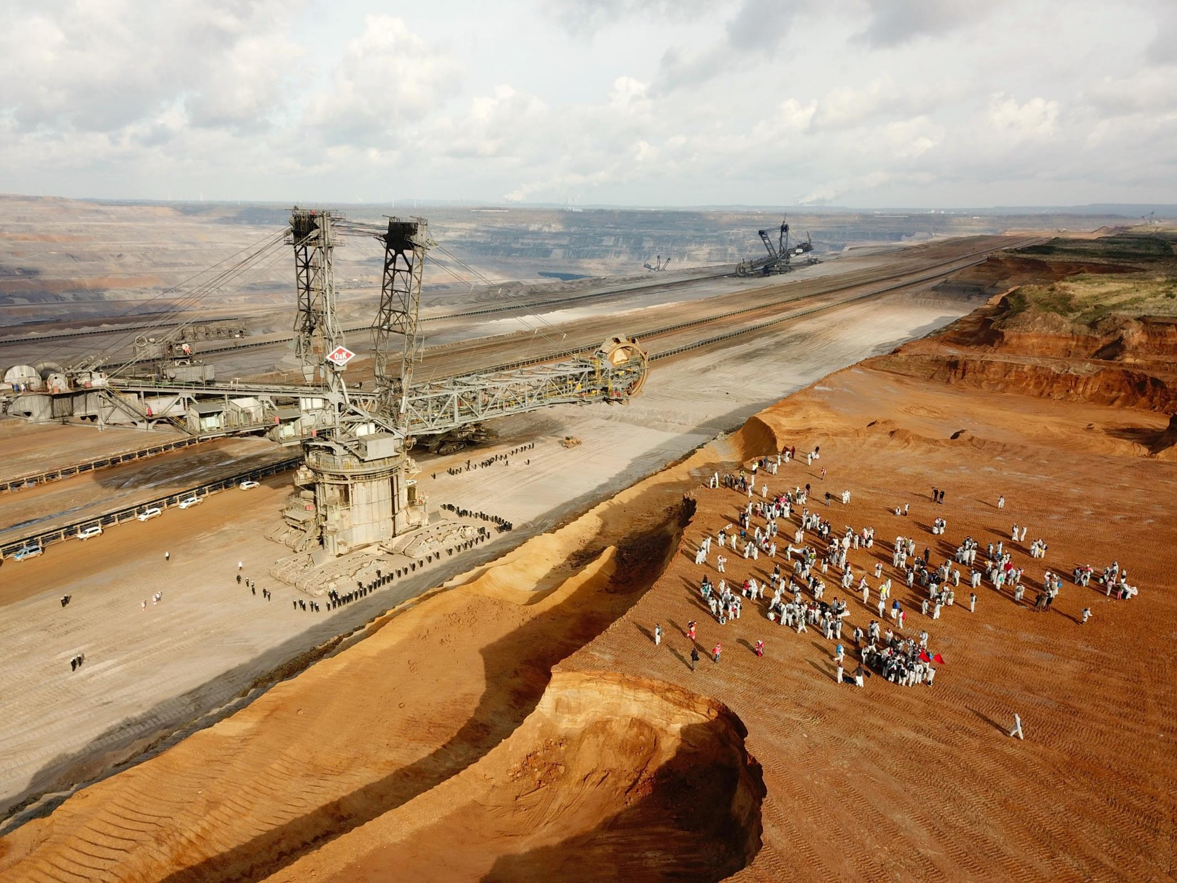
2) Frack off LNG!

Slide 7
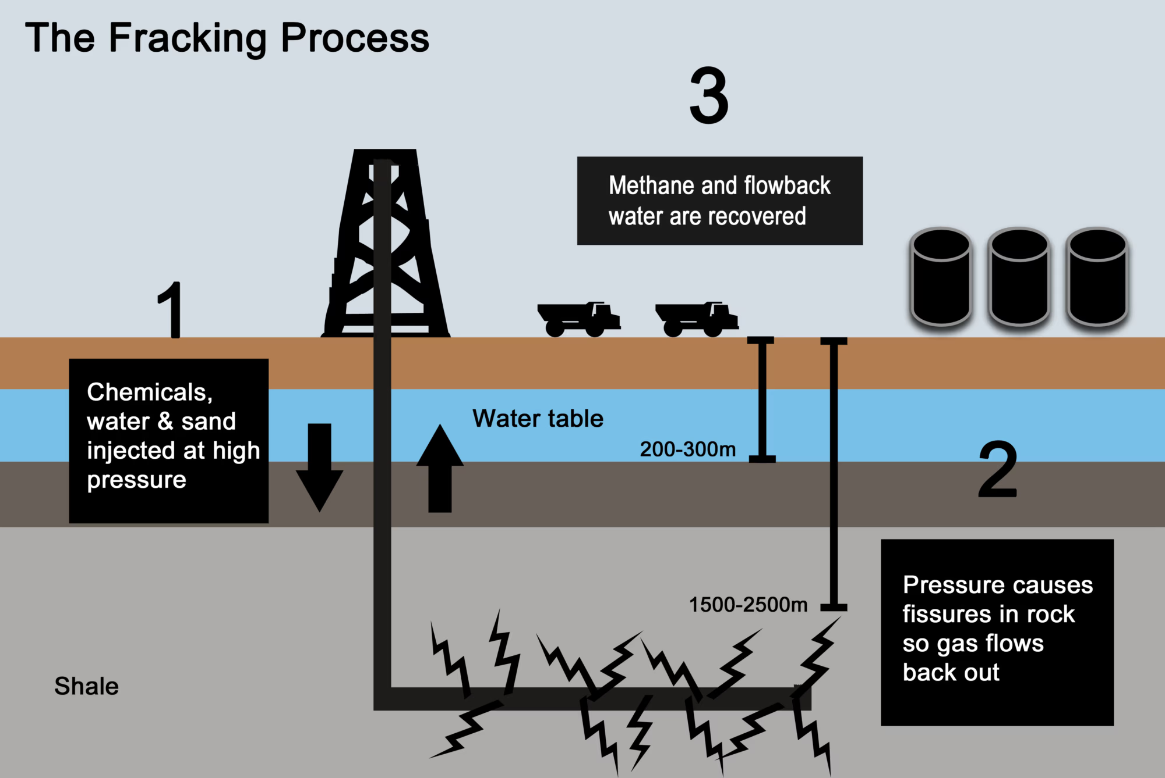
Frack off LNG!
Notes:
IPCC:
Assessment Reports 1990, 1995, 2001, 2007, 2014
Umweltgerechtigkeit!
80er Jahre
giftige Industrien vor allem bei PoCs

Slide 8
Liquified Natural Gas (LNG)
Hat Temperaturen um -162°C
Operates at temperatures around -162°C
Requires only 1/600th of the volume of normal gas Mainly used for shipping or as highly compressed fuel
Due to the Russian war of aggression in Ukraine, LNG is in high demand
A significant portion of the previously required natural gas came from Russia, and the import of LNG from other countries is intended to change that
The majority of LNG is imported from the United States (mostly from Texas), with other countries including Qatar, Nigeria, and Algeria Even
the German government considers LNG produced through fracking to be just as harmful to the climate, or even more so, than coal

Slide 9
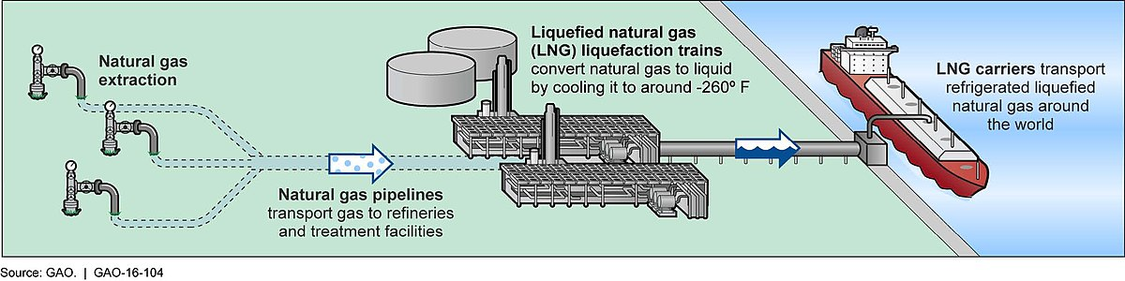
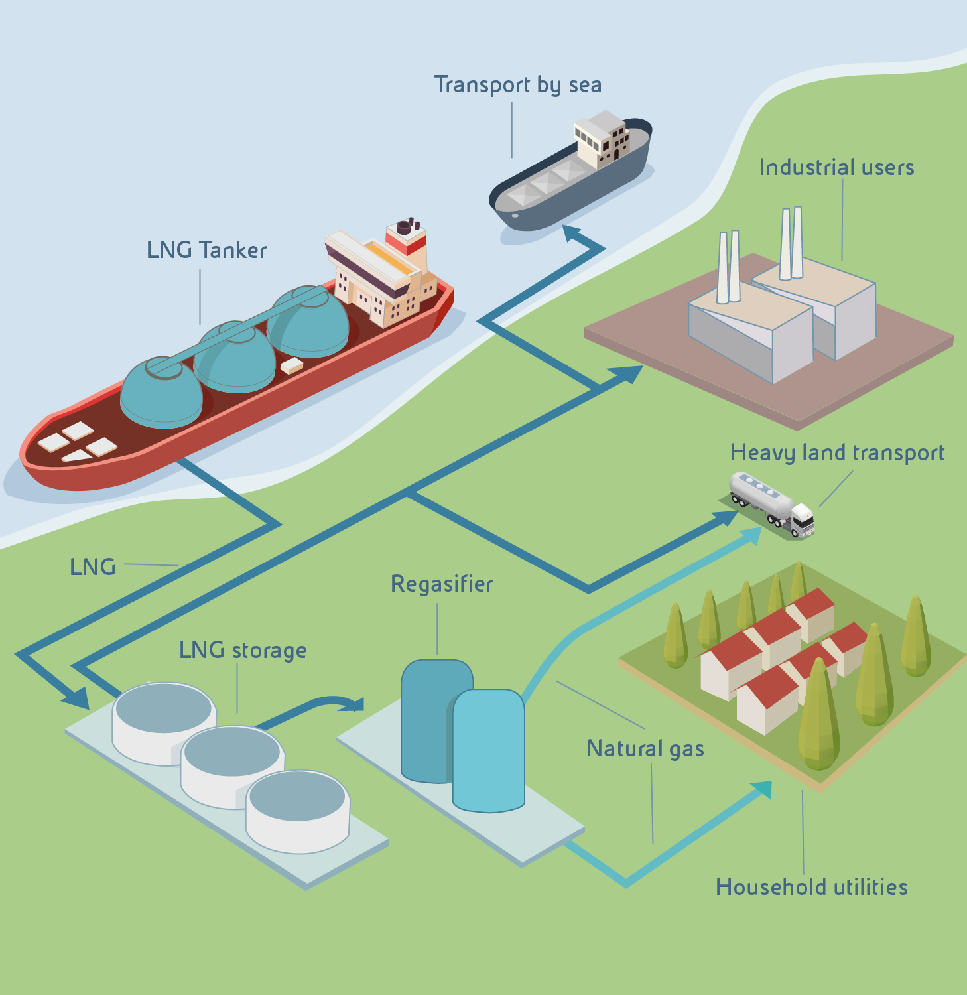
Liquified Natural Gas (LNG)

Slide 10
Frack off – Fracking in Texas
Fracking gas is considered the dirtiest gas in the world
Consequences include groundwater pollution (rendering it unusable), spread of harmful chemicals, health impacts, and complete destruction of landscapes
A study in 2019 linked the global increase in methane emissions to the fracking boom in the USA.
Another study in 2021 showed a doubling of earthquakes due to increased underground pressure from fracking
A study in 2022 indicated that people living near US fracking sites have shorter lifespans
Social consequences also include issues like human trafficking.
Notes:
Texas als wilder Westen der Fracking-Industrie: Methanabfackeln
10

Slide 11
(Neo-)colonial Continuity
In Texas, the health burdens of fracking are disproportionately borne by People of Color (PoC), Indigenous individuals, and socioeconomically disadvantaged people, who often have to work in the fracking sites themselves
In Colombia, fracking was approved by the right-conservative President Duque without recognizing the rights of Indigenous communities
Fracking also impacts Indigenous communities in Canada and Australia
In various other countries, Indigenous reserves and frontline communities are affected by this life-threatening technique, often enforced with state violence
Fracking continues the legacy of racially-colonial exploitation of people in the Global South and fundamentally infringes upon their rights and the rights of nature!
Notes:
Stop Oil Drilling in the (O)kavango by Canadian Co ReconAfrica - Action Network
11

Slide 12
Anti-democratic Processes
Since July 2022, the LNG Acceleration Act has been in place, resulting in protests and opposition
This law allows for the construction and operation of up to 12 terminals for the import of Liquefied Natural Gas (LNG) until 2043
Environmental impact assessments and the involvement of the public and environmental organizations have been partially bypassed for this purpose
Terminal locations include Wilhelmshaven, Stade, Brunsbüttel, Rostock, Hamburg, and Lubmin
The seven most likely projects would consume a significant portion of Germany's remaining CO₂ budget and render climate goals unattainable
In early July, the LNG Acceleration Act was also pushed through for Rügen before the Federal Council

Slide 13
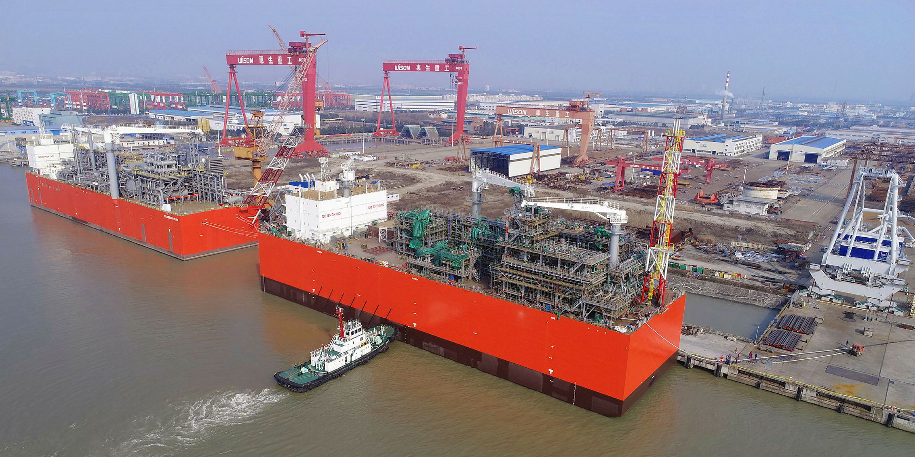
3) What is happening on Rügen?

Slide 14
What IS happening on rügen?
Mukran Port on Rügen: Largest LNG terminal in Europe
Summer 2023: Planned commencement of a mobile terminal ("FSRU") along with a 50 km long pipeline to Lubmin
FSRU "Floating Storage and Regasification Unit": Intended to receive, convert, and store shipped fracking gas from around the world
Accelerated approval process: Mandatory environmental assessments bypassed
Consequences: Significant damage to the Baltic Sea habitat, threat to underwater biotopes of vital importance to the overall marine ecosystem, adverse effects on fishing and tourism (= economic impact on the population)
Original location "Selling" prevented due to protests!

Slide 15
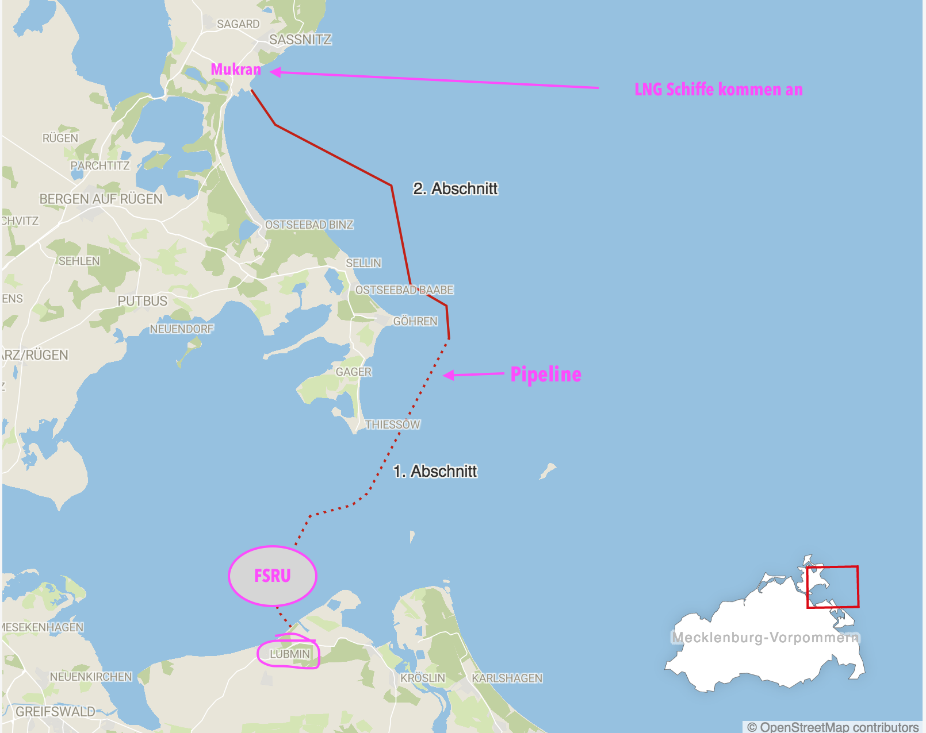
What IS happening on rügen?
Arrival of LNG Ships

Slide 16
akten
LOCAL protests on Rügen
Many citizen initiatives Are Active on Rügen
Collaboration primarily with "Lebenswertes Rügen" and "Rügen Nazifrei"
(Rügen Anti-Nazi movement)
Majority of mayors on Rügen actively opposed to the terminal
A few citizen initiatives are right-leaning (e.g., "Wir für Rügen" - "We for Rügen")
Main focus: Challenging the "not in my backyard" mentality
We aim for a different economy, particularly in the energy sector!
Expropriate Energy companies!

Slide 17
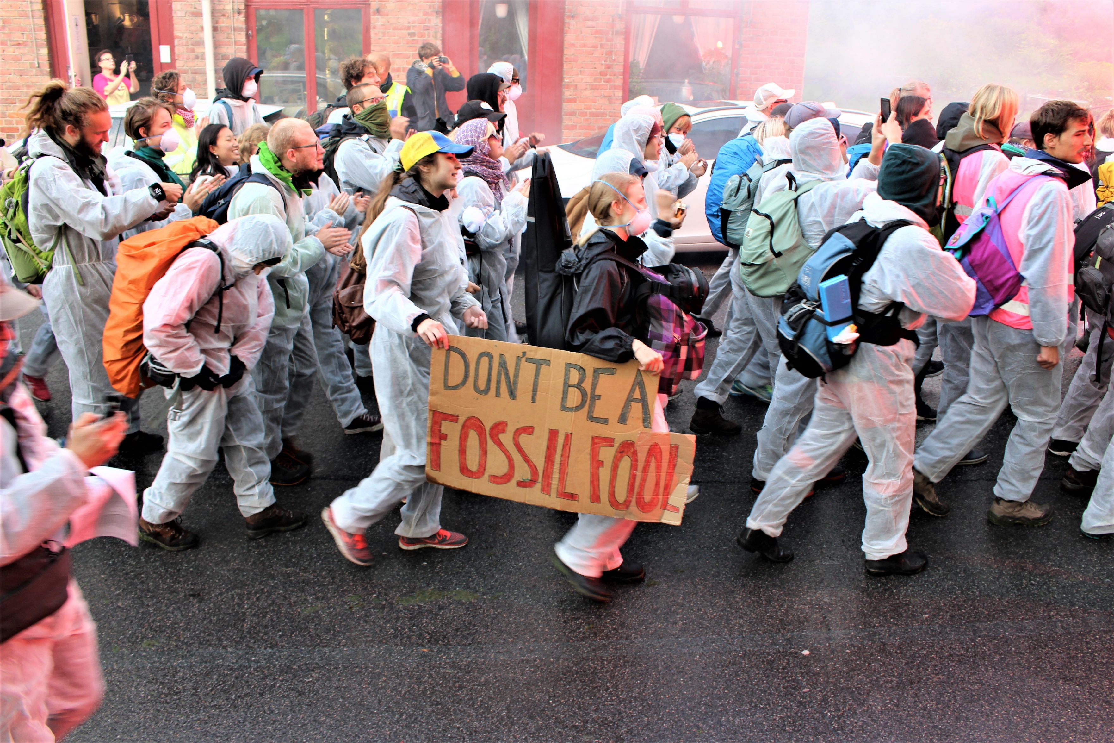
4) Ende Gelände GOES Rügen

Slide 18
WHY Civil disobedience against Gas?
No more fossil, colonial dead-end → Transition to renewable Energies NOW!
Analyses of energy security show: There is no emergency
No bridging technology
LNG is another climate catastrophe
LNG is another brutal form of colonial exploitation and destruction

Slide 19
Ende Gelände GOES Rügen
Wir ARE ANGRY!
We shut shit down!

Slide 20
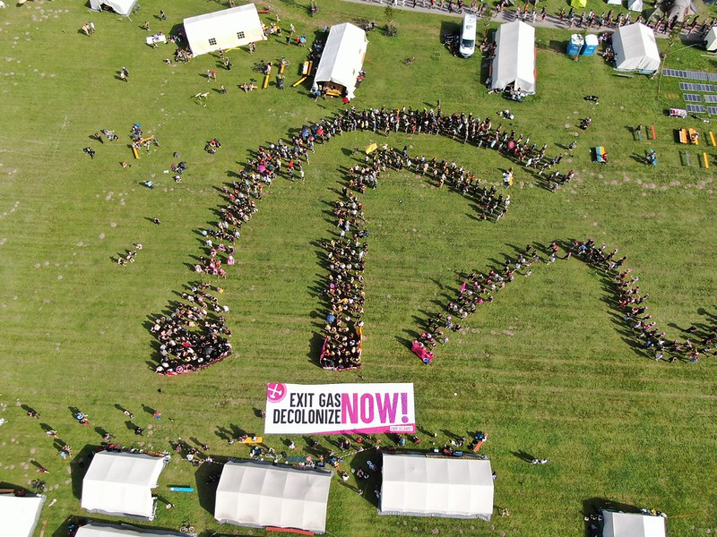
LNG = (Neo-)Colonial Destruction!

Slide 21
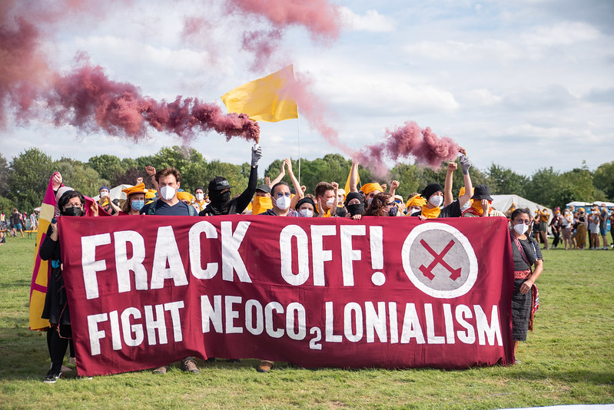

Slide 22
Massaction on Rügen
There will be a Camp: 20.-24.09.2023
Massaction: 22.-24.09.2023
Self-organization
1) Legal Workshops (2-3 Weeks before the Action)
2) Action trainings (Organise one in your city)
3) Bezugsgruppenabsprache (Organise one in your city)
→Stay tuned and up to date on www.ende-Gelaende.org

Slide 23
Rechtliche Folgen
Üblich: Hausfriedensbruch, Widerstand oder Verstoß gegen das Versammlungsgesetz, Selten: Landfriedensbruch.
Bisher keine EG- Verurteilungen, sondern nur Freisprüche und Einstellungen.
Bei Geldstrafen wird solidarisch Unterstützt.
Personalienverweigerung als kollektiver Schutz.
Gewahrsam möglich für Identitätsfeststellung, nach Platzverweis oder bei minderjährig gelesenen Menschen.
Mehr Infos: Rechtshilfebroschüre & Legal Team

Slide 24
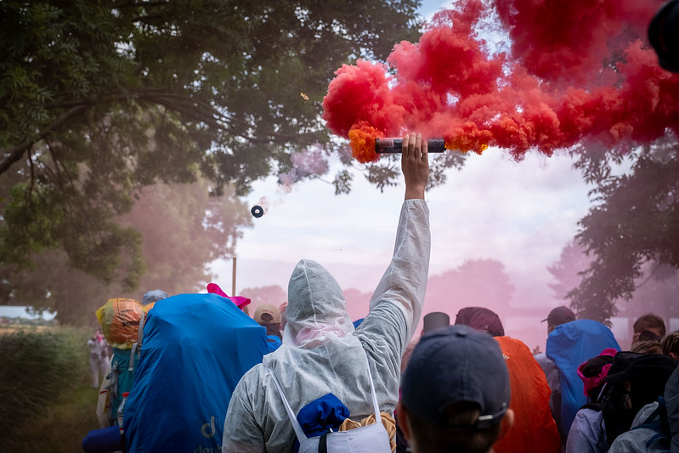

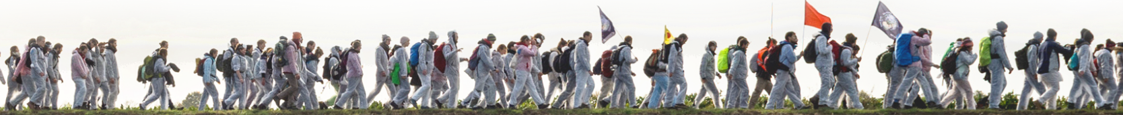
think global! block local! stop Fossil capitalism & LNG Shipping!
Notes:
MobiVideo Ende Gelände 2021 - YouTube
24

Slide 25
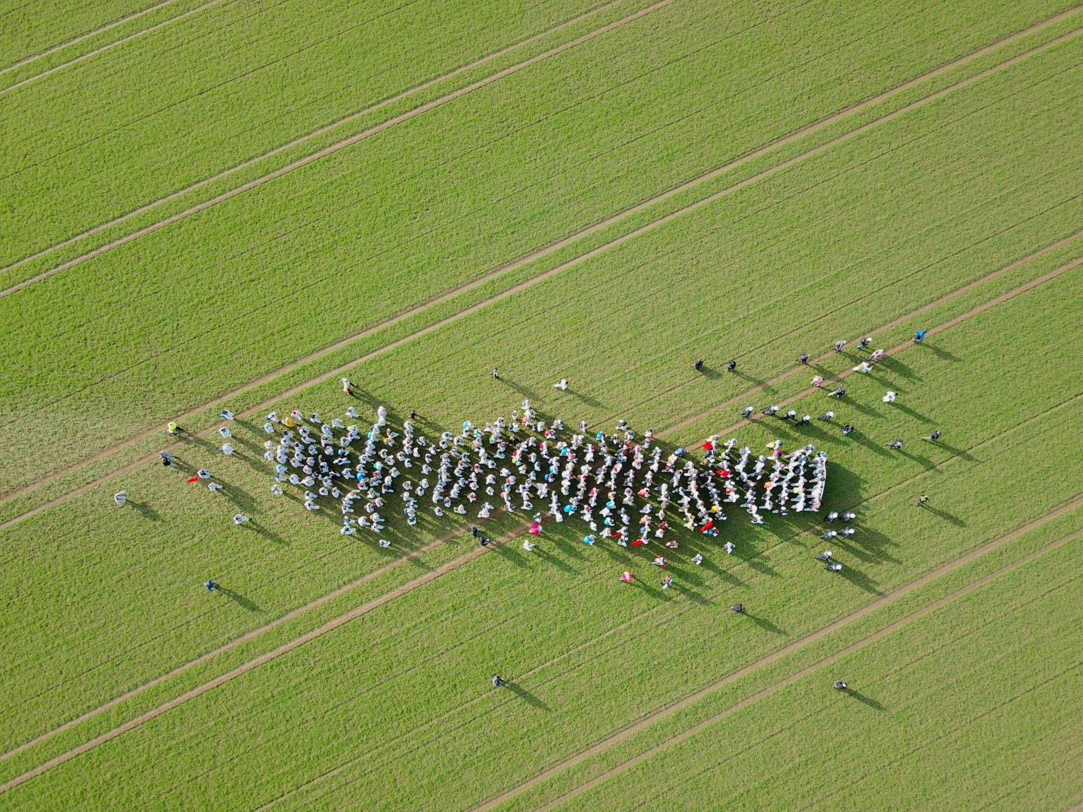
Questions?

